Slide 1
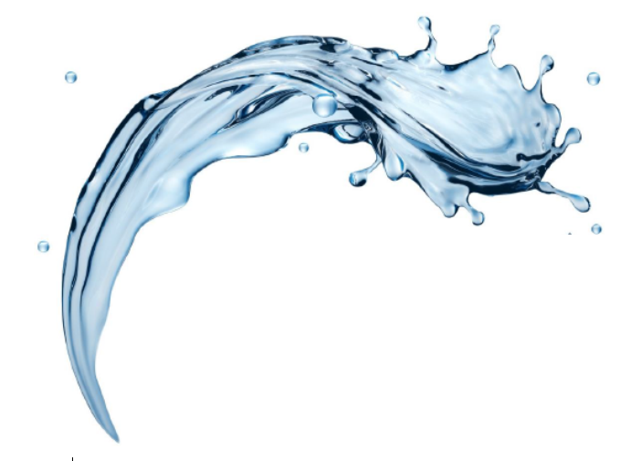

FilterSorb SP3
Nucleation and Mineralization:
Part VI
-by Deepak Chopra

Slide 2

Calcium carbonate Nucleation and Mineralization
For the formulation of CaCO3Precipitation
On
Layered Double Coating (LDC) on ->
3
S
P
Glass coated beads optimize the rate of crystallization process, and this effect is the most efficient. The FILTERSORB SP3 is a polymer with the hydrophilic coating of ceramic which exert the ability to bind calcium as a nucleation site of CaCO3 precipitation.
The unique glass surface reduces the total surface area, as surface areas without coating is larger and nucleation and growth of crystal become almost impossible. Without layered double coating (LDC), vaterite phase transit into calcite form. Calcite leaving the solution results scale on all surfaces.
The Calcium carbonate crystals precipitates on the glass surface of SP3 are 80% Aragonite and 20% calcite. Without glass coating only Calcite phase can be formed. Glass surface inhibit the growth of crystal during the process resulting in formation of small particles (sub-micron crystals).

Slide 3
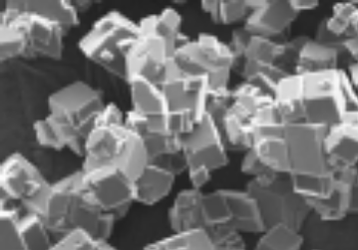
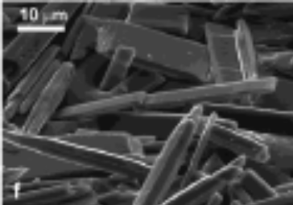
Selective Nucleation
Vaterie
+
Calcite
Slow Process
( ~ 30 Seconds)
Only Ceramic Polymer
(competition products, TAC)
(3 Sec)
Ca(HCO₃)₂
Water Hardness
Calcite (100%)
Vaterie
+
Aragonite
+
Calcite
Fast Process
( ≤ 10 Seconds)
With Glass Coating (LDC)
(FILTERSORB SP3)
(3 Sec)
Intermediate/meta-stable
phase
Aragonite (80%)
Calcite (20%)
TIME SCALE:
Fast crystallization processes have a greater tendency to form stable crystals than slow process
This figure demonstrates crystallization of insoluble Calcium carbonate in the presence of glass layered double coating (LDC). The meta-stable aragonite phase is preferentially stabilized over the thermodynamically more stable calcite phase. Only in the presence of this insoluble surface such aragonite particles posses an unconventional “ROSETTE-LIKE” morphology.

Slide 4
Selective Nucleation (continued...)
In all conventional surfaces without the LDC, intermediate stages of the crystallization, another meta-stable phase, vaterite, having a flaky-floret like crystallization which creates calcite scale. The presence of glass layer on the surface of ceramic polymer (LDC) is called selective nucleation of calcium carbonate.
The role of “non-soluble” glass-ions in affecting the “polymorph selectivity” is many times better than ions based on Calcium hydroxide (Ca(OH)2) , leaching out of beads without such glass layered double coating.
This is the first scale prevention media using LDC as an “insoluble inorganic material” to promote polymorph selectivity in calcium carbonate. This has a huge potential significance in Scale Prevention as well as descale with nucleation bio-mineralization.
Biometric synthesis of calcium carbonate is called bio-mineralization process. However, to date, no other company in the world has obtained to create pure aragonite by transformation of calcium carbonate at room temperature.
Only WATCH WATER SP3 can obtain Pure Aragonite!

Slide 5
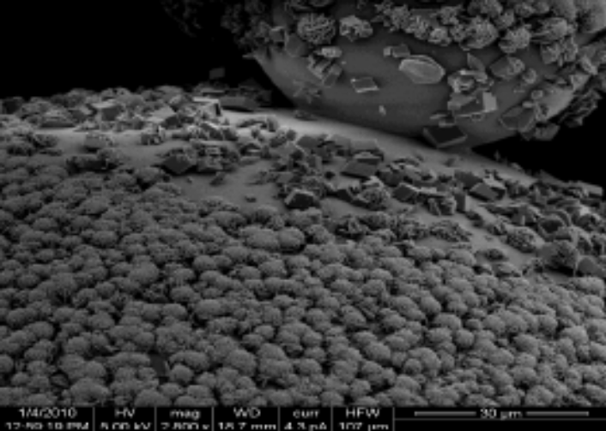
Conclusion
Both Precipitation and Crystallization are based on the speed of the process and the amount of the media in a pressure vessel. More media makes more crystals, also the size of the CaCO3 solid particle produced related to the amount of SP3 media. Precipitation process usually begin at higher surface area and the second most important factor is smooth surface of LDC area.
Very important is rapid nucleation and growth of CaCO3 crystals.
High surface without Glass coating is a result of aging which
creates larger particles of CaCO3 crystals as they appear in dishwashers, showerheads and any other surfaces which comes in contact of the treated water (e.g. competition products, acclaimed TAC media).
Crystal growth observed on smooth
glass surface Image courtesy:
University of Warwick, UK; Dept. Chemistry
We hope this description has provided some very valuable information for better understanding of Aragonite crystal growth and Nucleation and bio mineralization.
End of Part VI
Thanks for reading!

Slide 6


Watch Water® GmbH
Fahrlachstraße 14
68165 Mannheim
Germany
www.watchwater.de
info@watchwater.de
+49 (o)621 87951-0

